Slide 1


Department of BES1
Course: Data structures
Course code: 24sc1203
Topic:
Single linked list
Session – 2.1

Slide 2



AIM OF THE SESSION
To familiarize students with the basic concept of Single Linked list
INSTRUCTIONAL OBJECTIVES
This Session is designed to:
Demonstrate Limitations of Arrays and Advantages of Linked Lists
Describe Single Linked List
List out operations on Single Linked List.
Describe the creation and Insertion cases of Single Linked List
LEARNING OUTCOMES
At the end of this session, you should be able to:
Define Node, Single linked list
Describe Representation of Single Linked List and its operations.
Summarize Single Linked List

Slide 3
SESSION INTRODUCTION
Limitations of Arrays
The size of array must be known in advance before using it in the program.
Increasing size of the array is a time taking process. It is almost impossible to expand the size of the array at run time.
All the elements in the array need to be contiguously stored in the memory. Inserting any element in the array needs shifting of all its predecessors

Slide 4
Advantages of Linked lists
It allocates the memory dynamically.
All the nodes of linked list are non-contiguously stored in the memory and linked together with the help of pointers.
Sizing is no longer a problem since we do not need to define its size at the time of declaration.

Slide 5
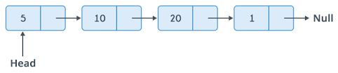
Single Linked List
A single linked list is a ordered set of elements in which every element has a link to its next element in sequence. singly linked list can be traversed only in one direction.
Each element in a linked list is called a node. A single node contains data and a pointer to the next node which helps in maintaining the structure of the list.

Slide 6
Structure of node in SLL(Cont..)
Struct linked list
{
int data;
struct linked list * next;
};

Slide 7
Operations On Linked List
Creation:This operation is used to create a linked list
Insertion:This operation is used to insert newnode in linked list
Deletion:This operation is used to delete the nodes from linked list.
Display:This operation is used to traverse the list and print the elements in the linked list.
Search:This operation is used to find a specific node in the linked list.

Slide 8
Creation
Functions we use to create a node in linked list
malloc() is used to dynamically allocate a single block of memory in C.
sizeof() is used to determine size in bytes of an element in C. Here it is used to determine size of each node and sent as a parameter to malloc.

Slide 9
Algorithm for Creating a Linked List
Step1:Declare a pointer *head.
Step2:Declare two node pointers say *newnode, *temp;
step3: create first node head = (struct node*)malloc(sizeof(struct node));
Step4:Input data and assign to head using
head->data = data;
Step5:At first head node points to NULL.
head->next = NULL;
temp = head.
.
step6: Allocate memory for newnode newNode = (struct node*)malloc(sizeof(structnode));
step7: Read data for new node.
newNode->data = data;
Step8: Now link previous node with newly created node temp->next = newNode;
Step9: Make current node as previous node using
temp = temp->next;
Repeat the steps 6 to 9

Slide 10
Insertion in Single Linked List(Cont..)
There are three possible positions where we can enter a new node in a linked list –
Insertion at beginning
Insertion at a specific position
Insertion at end

Slide 11
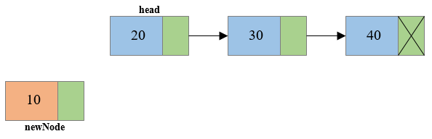
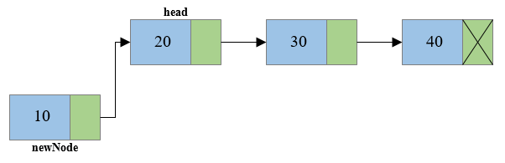
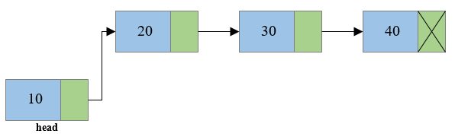
Insertion At Beginning of Single Linked List(Cont..)

Slide 12
Algorithm to Insert a node At Beginning of SLL
Step 1 - Create a newNode with given value.
Step 2 - Check whether list is Empty (head == NULL)
Step 3 - If it is Empty then, set newNode→next = NULL and head = newNode.
Step 4 - If it is Not Empty then, set newNode→next = head and head = newNode

Slide 13
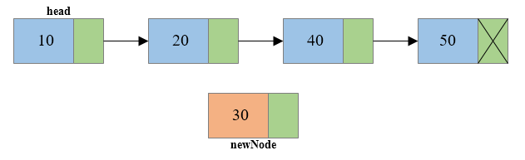
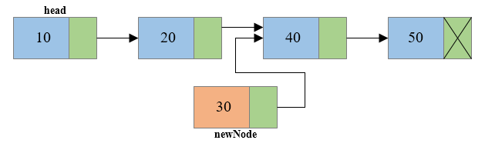
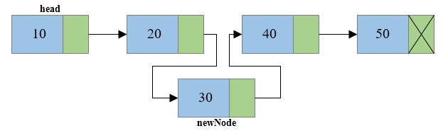
Insert a node At specific position in SLL
temp
temp
temp

Slide 14
Algorithm to Insert a node At specific position in SLL
Step 1 - Create a newNode with given value.
Step 2 - If list is Empty (head == NULL)
Step 3 -set newNode → next = NULL and head = newNode.
Step 4 - If it is Not Empty then, temp=head.
Step 5 - Keep moving the temp to its next node until it reaches to the node after which we want to insert the newNode
Step 6 - Every time check whether temp is reached to last node or not
Step 7 - Set newNode → next = temp → next and
temp → next = newNode

Slide 15
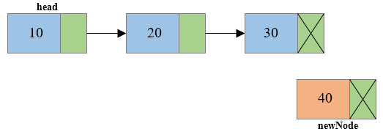
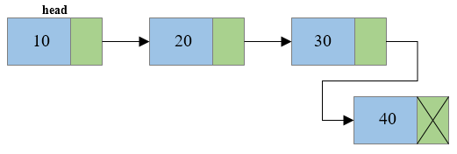
Insert a node At End of SLL
temp
temp

Slide 16
Algorithm to Insert a node at End of SLL
Step 1 - Create a newnode
newnode → next = NULL.
Step 2 - If list Empty then(head == NULL).
Step 3 - set head = newnode.
Step 4 - If it is Not Empty then, define a node pointer temp = head.
Step 5 - Keep moving the temp to its next node until it reaches to the last node in the list until ( temp → next =NULL).
Step 6 - Set temp → next = newnode.

Slide 17
Deletions in Single Linked List
There are three possible cases for deletion in Single Linked List
Deletion at beginning
Deletion of node in nth position
Deletion at end

Slide 18
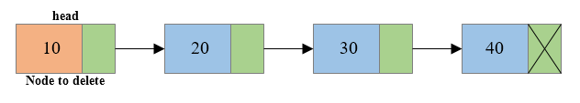
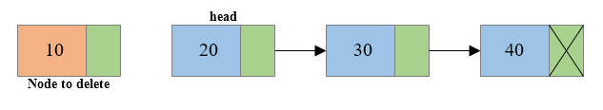

Deletion from Beginning of the List
temp

Slide 19
Algorithm to Delete a node from Beginning of SLL
Step 1 - Check whether list is Empty (head == NULL)
Step 2 - If it is Empty then, display 'List is Empty!!!
Step 3 - Else define a Node pointer 'temp' and initialize with head.
Step 4 - If list is having only one node
(temp → next == NULL)
Step 5 - If it is TRUE then set head = NULL and delete temp
Step 6 - If it is FALSE then set head = temp → next, and delete temp.

Slide 20
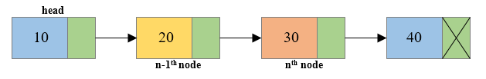
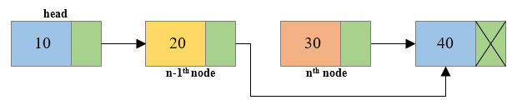
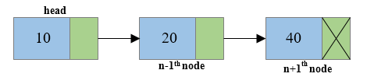
Deleting a node in specific Position
temp2
temp1

Slide 21
Algorithm to Delete a node in specific position in SLL
Step 1 - If list is Empty then (head == NULL)
Step 2 - If it is Empty then, display 'List is Empty!!!
Step 3 –Else define two Node pointers temp1,temp2 and
temp1=head;
Step 4 - Keep moving the temp1 until it reaches to the exact node to be deleted or to the last node. And every time set 'temp2 = temp1' before moving the 'temp1' to its next node.
Step 5 - If it is reached to the last node then display” Deletion not possible”.
Step 6 - If it is reached to the exact node which we want to delete, then check whether list is having only one node or not
Step 7 - If list has only one node then set head = NULL and delete temp1 (free(temp1)).
Step 8 - If list contains multiple nodes, then check whether temp1 is the first node in the list (temp1 ==head)
Step 9 - If temp1 is the first node then move the head to the next node (head = head → next) and delete temp1.
Step 10 - If temp1 is not first node then check whether it is last node in the list (temp1 → next == NULL).
Step 11 - If temp1 is last node then set temp2 →next = NULL delete temp1 (free(temp1)).
Step 12 - If temp1 is not first node and not last node then set
temp2 → next = temp1 → next
delete temp1 (free(temp1)).

Slide 22
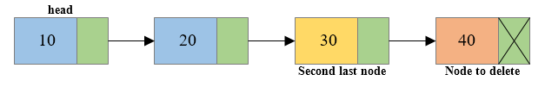
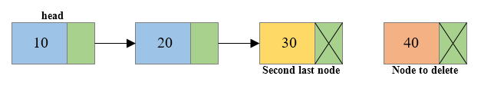
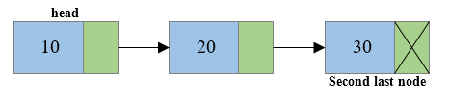
Delete a node from End of SLL
temp1 temp2
temp2
temp1
temp2

Slide 23
Algorithm to Delete a node at End of SLL
Step 1 - Check whether list is Empty (head == NULL)
Step 2 - If it is Empty then, display 'List is Empty!!!
Step 3 - If it is Not Empty then, define two Node pointers 'temp1' and 'temp2' and initialize 'temp1= head.
Step 4 - Check whether list has only one Node (temp1 → next == NULL)
Step 5 - If it is TRUE. Then, set head = NULL and delete temp1
Step 6 - If it is FALSE. Then, set 'temp2 = temp1 ' and move temp1 to its next node. Repeat the same until it reaches to the last node in the list. (until temp1 → next == NULL)
Step 7 - Finally, Set temp2 → next = NULL and delete temp1.

Slide 24
Display
Displaying the contents of a linked list is very simple. We keep moving the temp node to the next one and display its contents.
Algorithm
Step 1 - Check whether list is Empty (head == NULL)
Step 2 - If it is Empty then, display 'List is Empty‘
Step 3 - Else define a Node pointer temp and temp= head.
Step 4 - Keep displaying temp → data until temp reaches to the last node
Step 5 - Finally display temp → data .
temp

Slide 25
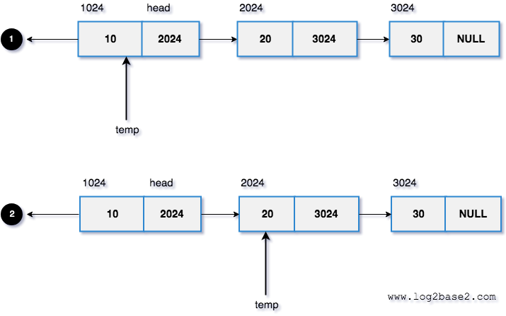
Searching a Node in SLL
Searching is performed in order to find the location of a particular element in the list. Searching any element in the list needs traversing through the list and make the comparison of every element of the list with the specified element. If the element is matched with any of the list element then the location of the element is returned from the function.
Search element =20
Search element

Slide 26
Algorithm to Search a Node in SLL
Step1:Initialize a node pointer, current = head.
Step 2: Do following while current is not NULL
  If the current value (i.e., current->key) is equal to the key being searched return true.
  Otherwise, move to the next node (current = current->next).
step 3:If the key is not found, return false

Slide 27
Few Exercises to Try out
Print the elements in the list in Reverse Order
Write a function to Concatenate two given list into one big list.
Insert an element in a linked list in sorted order.
Write a program in C to create a singly linked list of n nodes and count the number of nodes.
Write a C program to delete all nodes in Single Linked List.

Slide 28
Real Time Examples
Some example of single linked list.
Undo button of any application like Microsoft Word, Paint, etc: A linked list of states.
GPS Navigation: A linked list of map data. Travelling from origin to destination is example of traversing through all nodes. Rerouting by a GPS is an example of Add and Remove operations of map data.
Strategy for file allocation schemes by Operating System.
Some Real time appliations of single linked list.
Dynamic memory allocation: We use a linked list of free blocks.
Maintaining a directory of names

Slide 29
SUMMARY
A singly linked list is a type of linked list that is unidirectional, that is, it can be traversed in only one direction from head to the last node.
The time complexity for For insertion in the linked list, the time complexity is O(1) if done on the head, O(N) if done at any other location, as we need to reach that location by traversing the linked list.
For deletion, the time complexity is O(1), if done on the head, O(N), if done at any other location, as we need to reach that location by traversing the linked list.
For searching and accessing any elements, the involved time complexity is O(N).

Slide 30
SELF-ASSESSMENT QUESTIONS
A linear collection of data elements where the linear node is given by means of the pointer is called
a) Linked list
b) Node list
c) Tree
d) None of these
Which among the following segment of code inserts a new node pointed by X to be inserted at the beginning of the single linked list .The start pointer points to beginning of the linked list?
start->next=X;x=start;
X->next=start;start=X;
X->next=start->next;start=x;
X->next=start;start=x->next;
…

Slide 31
TERMINAL QUESTIONS
1. Describe Single Linked List
2. List out operations on Single Linked List
3. Analyze the time complexities of operations on Single Linked lists
4. Summarize Single Linked List

Slide 32
REFERENCES FOR FURTHER LEARNING OF THE SESSION
Reference Books:
1. A.v.Aho,J.E.Hopcroft,and J.D.Ullman ,”Data structures And Algorithms”,Pearson Education 1e.
2. “Fundamentals of Data Structures in C”,Horowitz,Sahni,Anderson Freed 2e-2007
3.R.F.Gilberg,B.A.Forouzan,”Data Structures” 2e Thomson India Edition-2007
Sites and Web links:
1. https://nptel.ac.in/courses/106102064
2. https://www.edx.org/course/algorithms -and -data-structures-1
3. https://www.coursera.org/learn/data-structures?action=enroll

Slide 33
THANK YOU
Team – Course Name

